Slide 1
Chapter Overview
String Primitive Instructions
Two-Dimensional Arrays
Irvine, Kip R. Assembly Language for x86 Processors 6/e, 2010.

Slide 2
String Primitive Instructions
MOVSB, MOVSW, and MOVSD
CMPSB, CMPSW, and CMPSD
SCASB, SCASW, and SCASD
STOSB, STOSW, and STOSD
LODSB, LODSW, and LODSD
Irvine, Kip R. Assembly Language for x86 Processors 6/e, 2010.

Slide 3
MOVSB, MOVSW, and MOVSD (1 of 2)
The MOVSB, MOVSW, and MOVSD instructions copy data from the memory location pointed to by ESI to the memory location pointed to by EDI.
.data
source DWORD 0FFFFFFFFh
target DWORD ?
.code
mov esi,OFFSET source
mov edi,OFFSET target
movsd
Irvine, Kip R. Assembly Language for x86 Processors 6/e, 2010.

Slide 4
MOVSB, MOVSW, and MOVSD (2 of 2)
ESI and EDI are automatically incremented or decremented:
  MOVSB increments/decrements by 1
  MOVSW increments/decrements by 2
  MOVSD increments/decrements by 4
Irvine, Kip R. Assembly Language for x86 Processors 6/e, 2010.

Slide 5
Direction Flag
The Direction flag controls the incrementing or decrementing of ESI and EDI.
  DF = clear (0): increment ESI and EDI
  DF = set (1): decrement ESI and EDI
The Direction flag can be explicitly changed using the CLD and STD instructions:
CLD ; clear Direction flag
STD ; set Direction flag
Irvine, Kip R. Assembly Language for x86 Processors 6/e, 2010.

Slide 6
Using a Repeat Prefix
REP (a repeat prefix) can be inserted just before MOVSB, MOVSW, or MOVSD.
ECX controls the number of repetitions
Example: Copy 20 doublewords from source to target
.data
source DWORD 20 DUP(?)
target DWORD 20 DUP(?)
.code
cld ; direction = forward
mov ecx,LENGTHOF source ; set REP counter
mov esi,OFFSET source
mov edi,OFFSET target
rep movsd
Irvine, Kip R. Assembly Language for x86 Processors 6/e, 2010.

Slide 7
Your turn . . .
Use MOVSD to delete the first element of the following doubleword array. All subsequent array values must be moved one position forward toward the beginning of the array:
  array DWORD 1,1,2,3,4,5,6,7,8,9,10
.data
array DWORD 1,1,2,3,4,5,6,7,8,9,10
.code
cld
mov ecx,(LENGTHOF array) - 1
mov esi,OFFSET array+4
mov edi,OFFSET array
rep movsd
Irvine, Kip R. Assembly Language for x86 Processors 6/e, 2010.

Slide 8
CMPSB, CMPSW, and CMPSD
The CMPSB, CMPSW, and CMPSD instructions each compare a memory operand pointed to by ESI to a memory operand pointed to by EDI.
  CMPSB compares bytes
  CMPSW compares words
  CMPSD compares doublewords
Repeat prefix often used
  REPE (REPZ)
  REPNE (REPNZ)
Irvine, Kip R. Assembly Language for x86 Processors 6/e, 2010.

Slide 9
Comparing a Pair of Doublewords
If source > target, the code jumps to label L1; otherwise, it jumps to label L2
.data
source DWORD 1234h
target DWORD 5678h
.code
mov esi,OFFSET source
mov edi,OFFSET target
cmpsd ; compare doublewords
ja L1 ; jump if source > target
jmp L2 ; jump if source <= target
Irvine, Kip R. Assembly Language for x86 Processors 6/e, 2010.

Slide 10
Your turn . . .
Modify the program in the previous slide by declaring both source and target as WORD variables. Make any other necessary changes.
Irvine, Kip R. Assembly Language for x86 Processors 6/e, 2010.

Slide 11
Comparing Arrays
Use a REPE (repeat while equal) prefix to compare corresponding elements of two arrays.
.data
source DWORD COUNT DUP(?)
target DWORD COUNT DUP(?)
.code
mov ecx,COUNT ; repetition count
mov esi,OFFSET source
mov edi,OFFSET target
cld ; direction = forward
repe cmpsd ; repeat while equal
; The REPE prefix repeats the comparison, incrementing ESI and EDI automatically until ECX equals zero or a pair of doublewords is found to be different.
Irvine, Kip R. Assembly Language for x86 Processors 6/e, 2010.

Slide 12
Example: Comparing Two Strings (1 of 3)
This program compares two strings (source and destination). It displays a message indicating whether the lexical value of the source string is less than the destination string.
.data
source BYTE "MARTIN "
dest BYTE "MARTINEZ"
str1 BYTE "Source is smaller",0dh,0ah,0
str2 BYTE "Source is not smaller",0dh,0ah,0
Source is smaller
Screen output:
Irvine, Kip R. Assembly Language for x86 Processors 6/e, 2010.

Slide 13
Example: Comparing Two Strings (2 of 3)
.code
main PROC
  cld ; direction = forward
  mov esi,OFFSET source
  mov edi,OFFSET dest
  mov ecx,LENGTHOF source
  repe cmpsb
  jb source_smaller
  mov edx,OFFSET str2 ; "source is not smaller"
  jmp done
source_smaller:
  mov edx,OFFSET str1 ; "source is smaller"
done:
  call WriteString
  exit
main ENDP
END main
Irvine, Kip R. Assembly Language for x86 Processors 6/e, 2010.

Slide 14
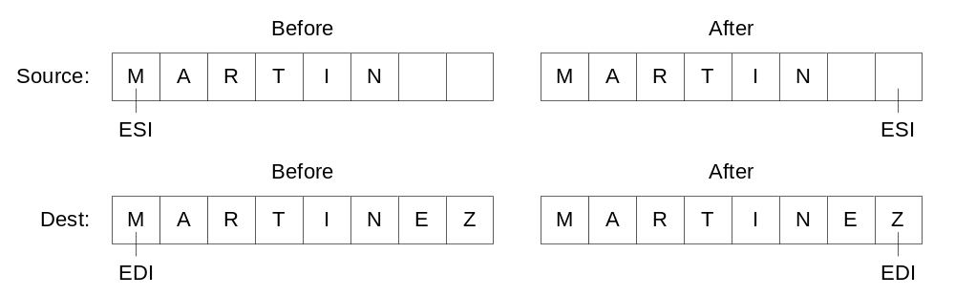
Example: Comparing Two Strings (3 of 3)
The following diagram shows the final values of ESI and EDI after comparing the strings:
Irvine, Kip R. Assembly Language for x86 Processors 6/e, 2010.

Slide 15
SCASB, SCASW, and SCASD
The SCASB, SCASW, and SCASD instructions compare a value in AL/AX/EAX to a byte, word, or doubleword, respectively, addressed by EDI.
Useful types of searches:
  Search for a specific element in a long string or array.
  Search for the first element that does not match a given value.
Irvine, Kip R. Assembly Language for x86 Processors 6/e, 2010.

Slide 16
SCASB Example
Search for the letter 'F' in a string named alpha:
.data
alpha BYTE "ABCDEFGH",0
.code
mov edi,OFFSET alpha
mov al,'F' ; search for 'F'
mov ecx,LENGTHOF alpha
cld
repne scasb ; repeat while not equal
jnz quit
dec edi ; EDI points to 'F'
What is the purpose of the JNZ instruction?
Irvine, Kip R. Assembly Language for x86 Processors 6/e, 2010.

Slide 17
STOSB, STOSW, and STOSD
The STOSB, STOSW, and STOSD instructions store the contents of AL/AX/EAX, respectively, in memory at the offset pointed to by EDI.
Example: fill an array with 0FFh
.data
Count = 100
string1 BYTE Count DUP(?)
.code
mov al,0FFh ; value to be stored
mov edi,OFFSET string1 ; ES:DI points to target
mov ecx,Count ; character count
cld ; direction = forward
rep stosb ; fill with contents of AL
Irvine, Kip R. Assembly Language for x86 Processors 6/e, 2010.

Slide 18
LODSB, LODSW, and LODSD
LODSB, LODSW, and LODSD load a byte or word from memory at ESI into AL/AX/EAX, respectively.
Example:
.data
array BYTE 1,2,3,4,5,6,7,8,9
.code
mov esi,OFFSET array
mov ecx,LENGTHOF array
cld
L1: lodsb ; load byte into AL
or al,30h ; convert to ASCII
call WriteChar ; display it
loop L1
Irvine, Kip R. Assembly Language for x86 Processors 6/e, 2010.

Slide 19
Array Multiplication Example
Multiply each element of a doubleword array by a constant value.
.data
array DWORD 1,2,3,4,5,6,7,8,9,10
multiplier DWORD 10
.code
cld ; direction = up
mov esi,OFFSET array ; source index
mov edi,esi ; destination index
mov ecx,LENGTHOF array ; loop counter
L1: lodsd ; copy [ESI] into EAX
mul multiplier ; multiply by a value
stosd ; store EAX at [EDI]
loop L1
Irvine, Kip R. Assembly Language for x86 Processors 6/e, 2010.

Slide 20
Your turn . . .
Write a program that converts each unpacked binary-coded decimal byte belonging to an array into an ASCII decimal byte and copies it to a new array.
.data
array BYTE 1,2,3,4,5,6,7,8,9
dest BYTE (LENGTHOF array) DUP(?)
mov esi,OFFSET array
mov edi,OFFSET dest
mov ecx,LENGTHOF array
cld
L1: lodsb ; load into AL
or al,30h ; convert to ASCII
stosb ; store into memory
loop L1
Irvine, Kip R. Assembly Language for x86 Processors 6/e, 2010.

